Slide 1



Software Tool Time

Slide 2
ABOUT
Tutor
KIM JUN YOUNG - 201920765
Objectives
To know → How ‘Unity Netcode’ works.
Preparation
Unity 2020.3, 2021.1, and 2021.2 or higher.
Mono and IL2CPP Scripting Backends.
Visual Studio 2019 or higher.
Git
MAY 2022 / (CC-BY-NC 4.0) KIM JUN YOUNG and Ajou University

Slide 3
What is Unity NETCODE?
Unity NETCODE is a mid-level networking library built for the Unity game engine to abstract networking.
This allows you, the developer to focus on your game rather than low-level protocols and networking frameworks.
The network library for Unity Engine.

Slide 4



What is Network Library?

Slide 5
RPC: Remote Procedure Call
They are ways to call methods on objects that are not in the same executable.
Client RPC → A Client Rpc can be invoked by the server to be executed on a client.
Server RPC → A Server Rpc can be invoked by a client to be executed on the server.

Slide 6
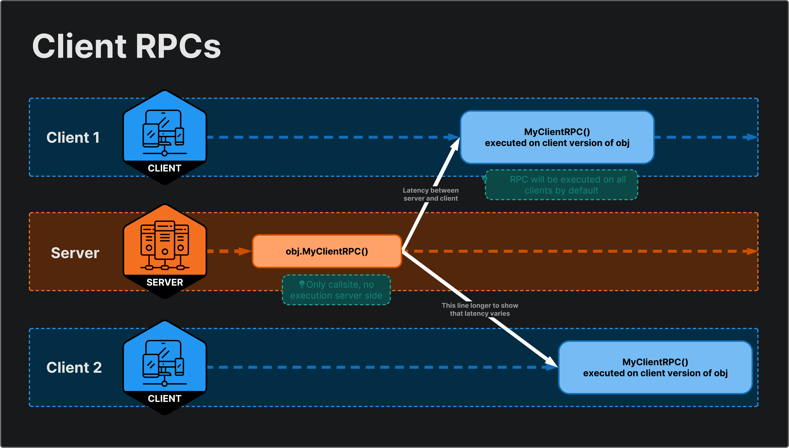
Client RPC

Slide 7
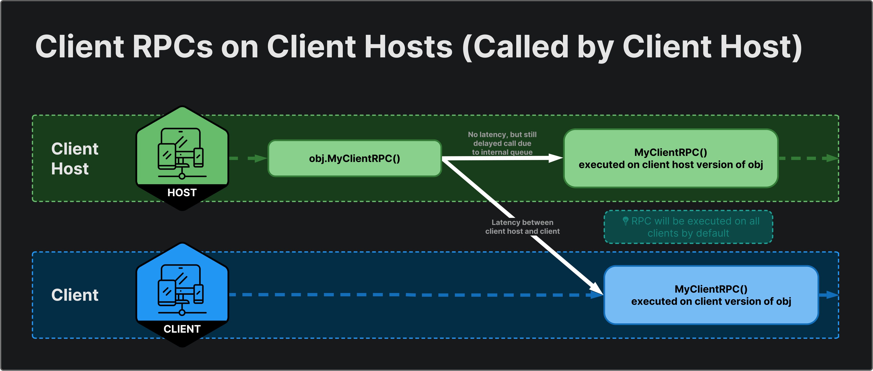
Client RPC

Slide 8
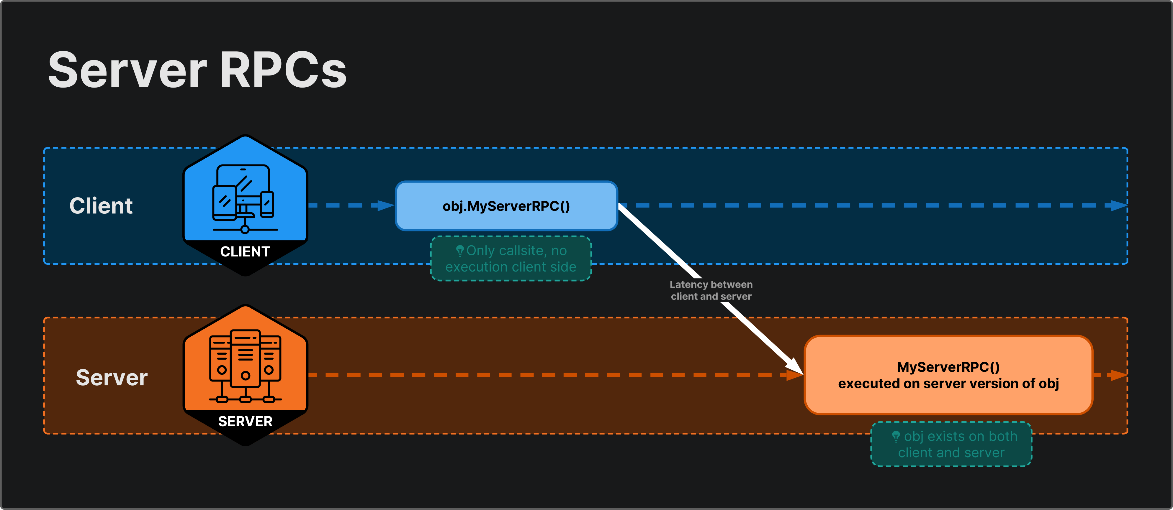
Server RPC

Slide 9
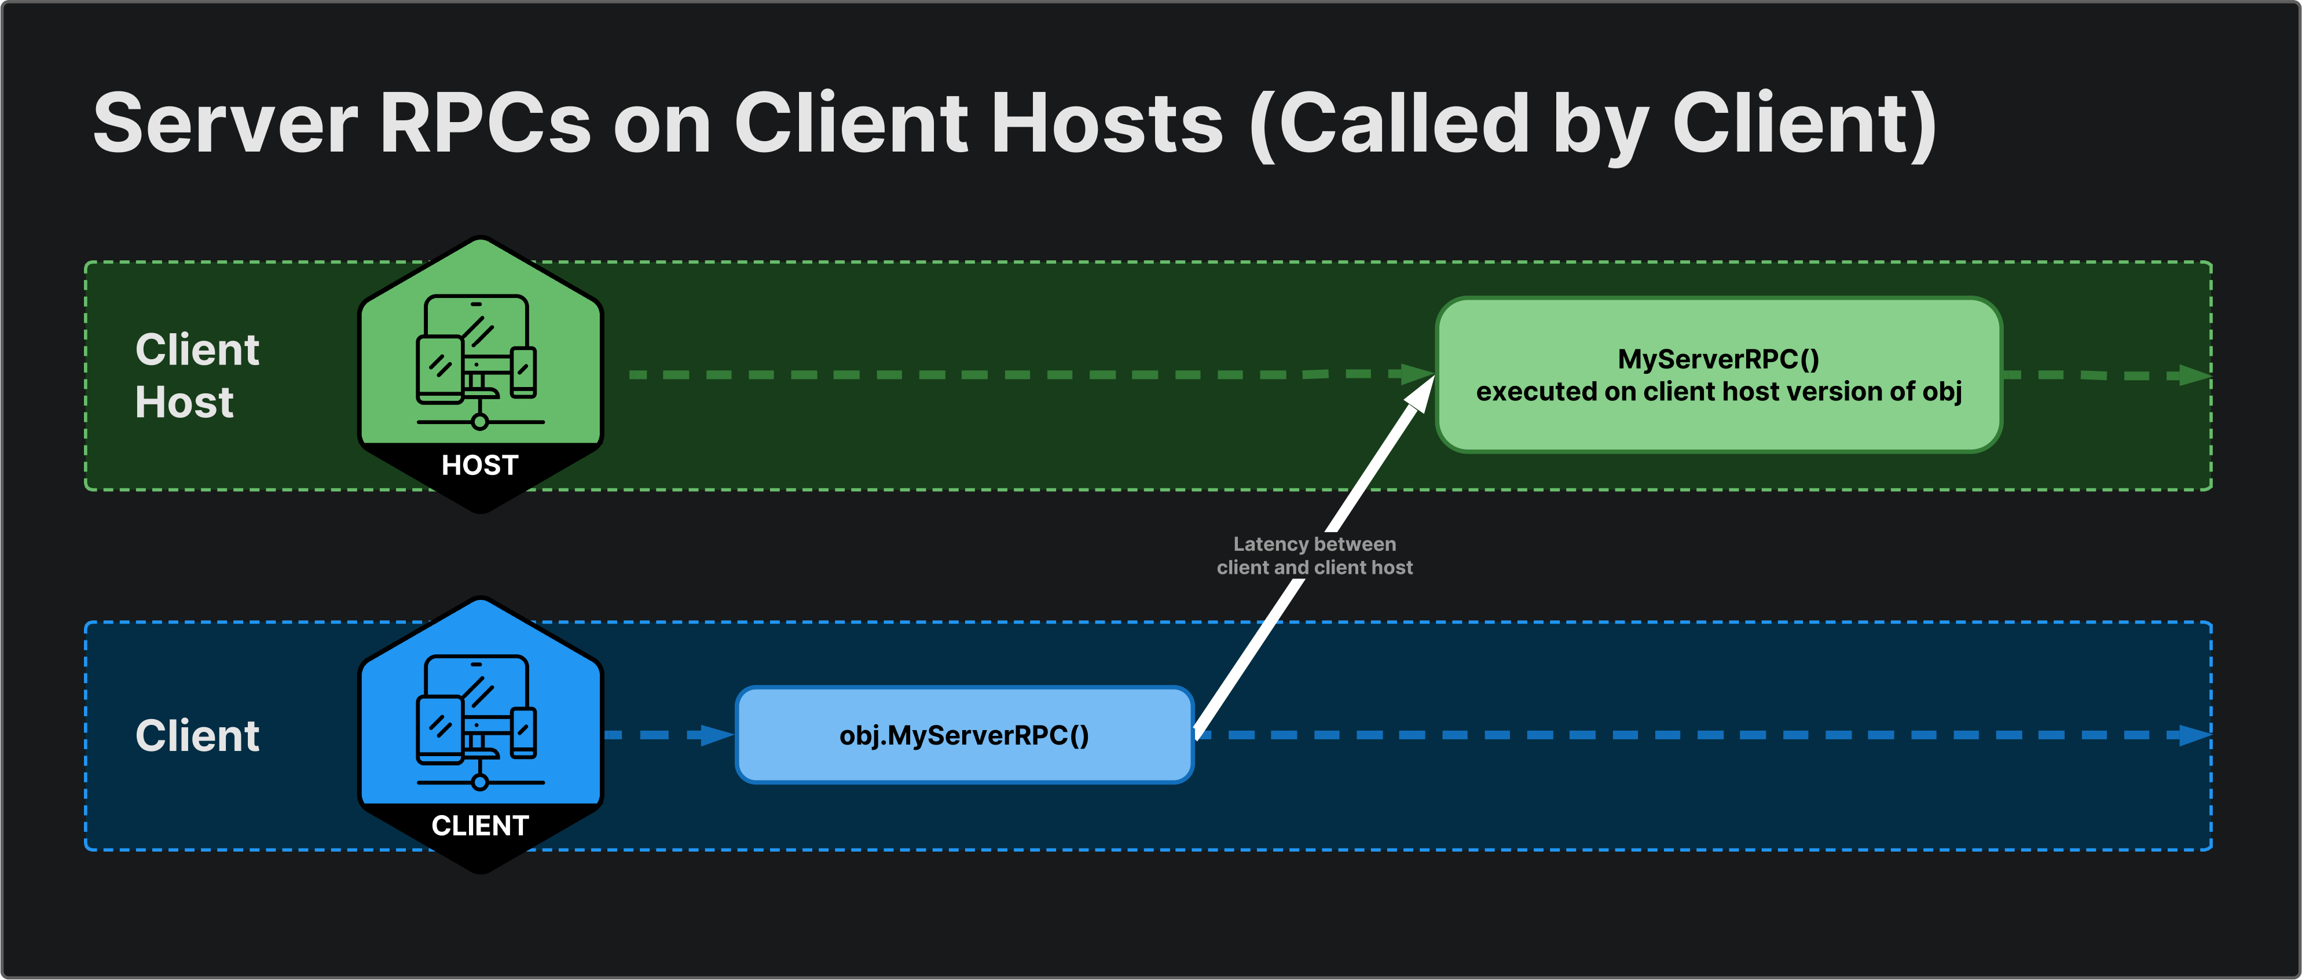
Server RPC

Slide 10
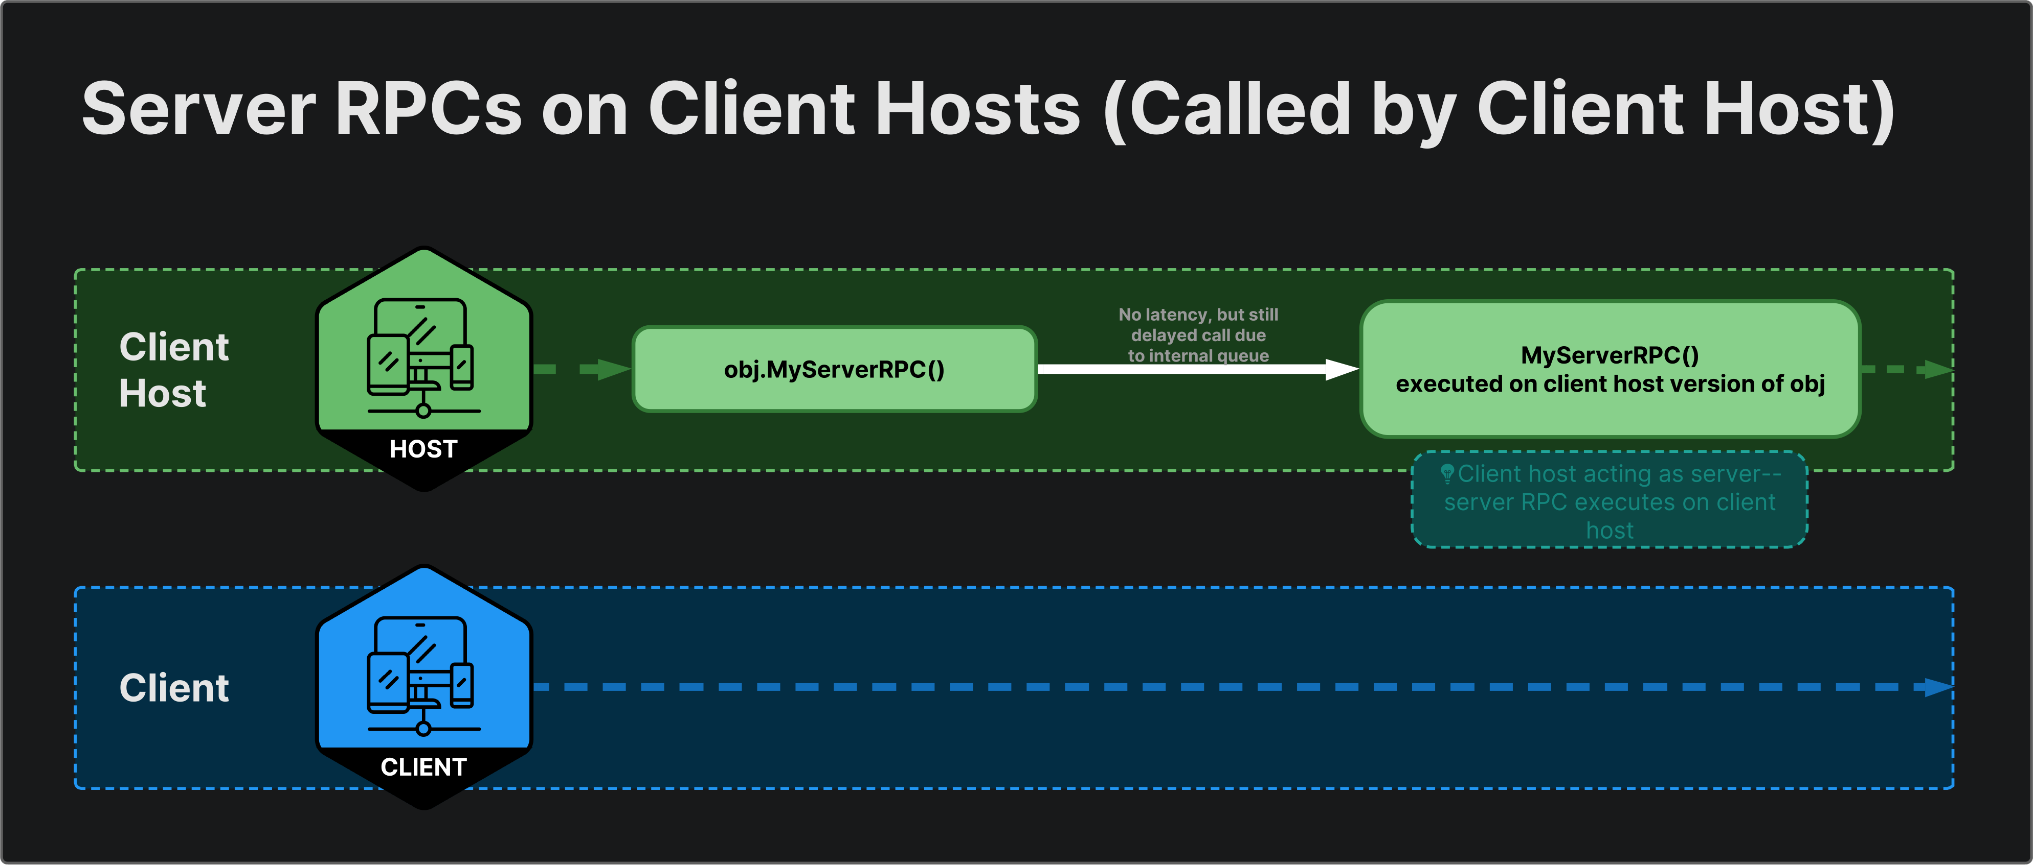
Server RPC

Slide 11
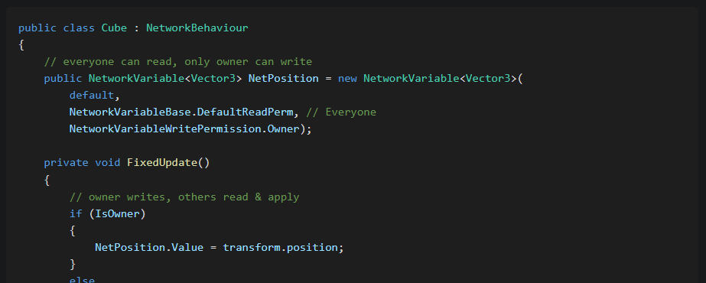
Network variable

Slide 12
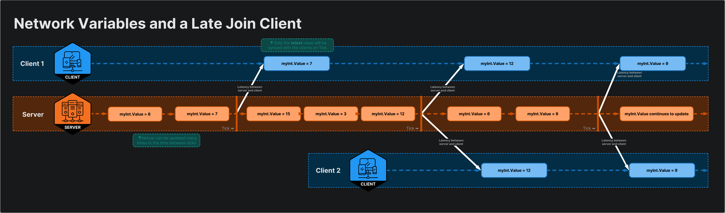
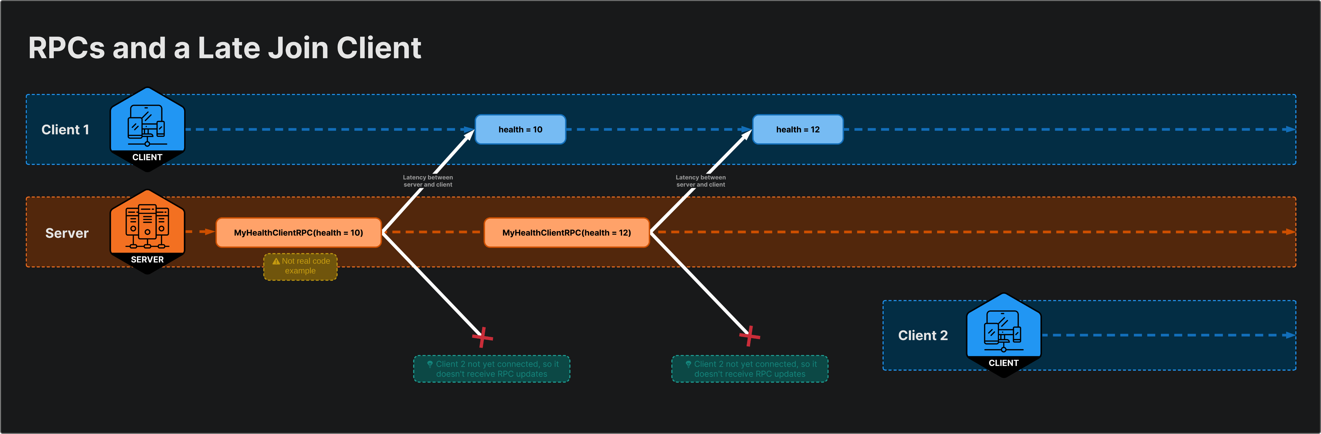
RPC vs Network variables

Slide 13
Software Tool Time (소프트웨어 툴 타임)
(CC-BY-NC 4.0) KIM JUN YOUNG and Ajou University
Visit “Software Tool Time” channel in YouTube : http://goo.gl/remxrw
This video was supported by the Khronos Group
All product names, trademarks, and/or company names are used solely for identification and belong to their respective owners.
“Software Tool Time” video is licensed to the public under a Creative Commons Attribution 4.0 License (https://creativecommons.org/license/by/4.0/)
Twin Musicom’s African Drums (Sting) is licensed to the to the public under a Creative Commons Attribution 4.0 License (Artist: http://www.twinmusicom.org/)

